Slide 1
TAKE ACTION TO REDUCE HIGH RADON LEVELS
Messages for general public
#PrEvCan #CANCERCODE
The PrEvCan campaign was initiated by EONS and is run in association with key campaign partner, ESMO. More info: www.cancernurse.eu/prevcan

Slide 2
Insert logo of your organization
here
TAKE ACTION TO REDUCE HIGH RADON LEVELS
Find out whether you are exposed to radiation from naturally high radon levels in your home
#PrEvCan #CANCERCODE
The PrEvCan campaign was initiated by EONS and is run in association with key campaign partner, ESMO. More info: www.cancernurse.eu/prevcan

Slide 3
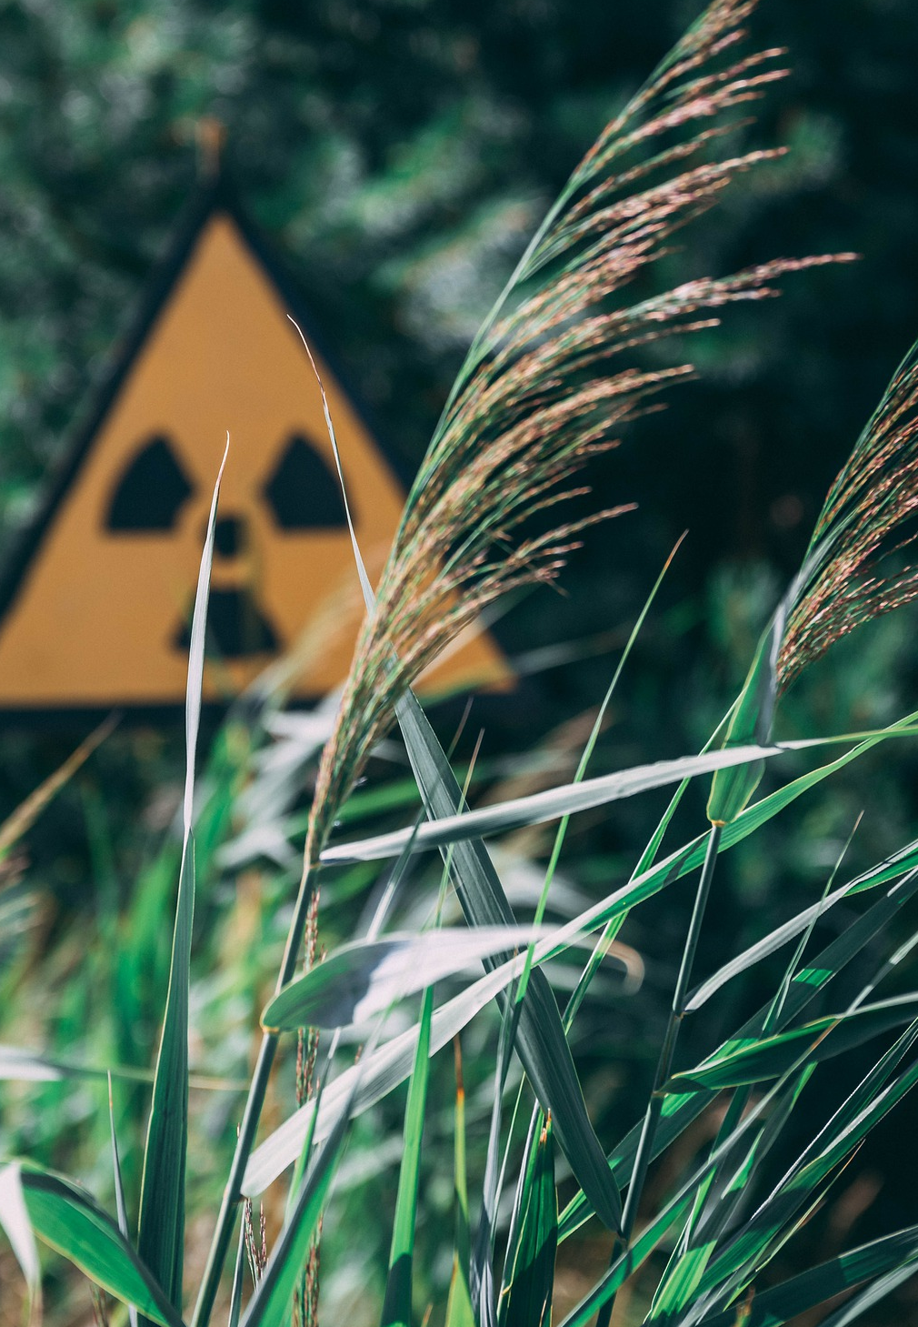
Insert logo of your organization
here
TAKE ACTION TO REDUCE HIGH RADON LEVELS
Radon is a natural radioactive gas that may cause radiation exposure in your home
#PrEvCan #CANCERCODE
The PrEvCan campaign was initiated by EONS and is run in association with key campaign partner, ESMO. More info: www.cancernurse.eu/prevcan

Slide 4
Insert logo of your organization
here
TAKE ACTION TO REDUCE HIGH RADON LEVELS
Paste your photo
Customized message
#PrEvCan #CANCERCODE
The PrEvCan campaign was initiated by EONS and is run in association with key campaign partner, ESMO. More info: www.cancernurse.eu/prevcan

